Slide 1
RAMP PROJECT
Airplane passenger load prediction
Tommy Tran – Thomas de Mareuil

Slide 2
RAMP Submission: 2Tomsbetterthan1
Final Model: XGBoost
Final test RMSE: 0.252

Slide 3
Context and objectives
Data Exploration (EDA) and Feature Engineering
Prediction (Model, Hyperparameters)
Conclusion

Slide 4
I. Context and objectives
Goals
Inputs
Forecast airplane passengers load in the US
Derive conclusions and critical point of view
Practice ML techniques with real data
Training data : data about US domestic flights, from 2011 to 2013
External data : meteorological data about US airports
Roadmap
Find additional external data
Clean and merge with preexisting data
Final conclusions and report
Oral presentation
Delivery
Data collection
Model selection
Try several models, pick best
Try model averaging / stacking
Iterate between steps
Data engineering
Feature encoding
Feature relevance
Hyperpar. tuning
Use grid search to select best param.
Assess model
4

Slide 5
Context and objective
Data Exploration (EDA) and Feature Engineering
Prediction (Model, Hyperparameters)
Conclusion

Slide 6
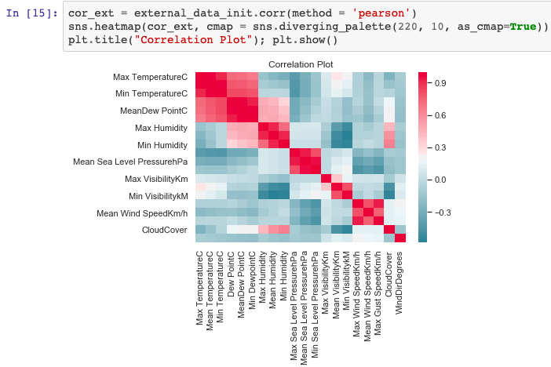
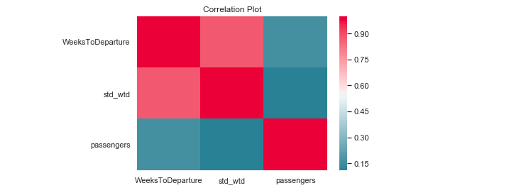
II. Data Exploration (EDA) and Feature Engineering
Initial datasets
Training data
8902 US domestic flights, from and to 20 different airports
6 variables: date (09/01/2011 - 03/05/2013), departure and arrival airports, how early tickets were booked (in weeks and stdev), number of passengers (our predicted variable)
No missing values, low skewness
Correlation led us to drop std_wtd.
External data
11,040 observations, over our timer period and 20 airports
22 meteorological features
Based on correlation, we kept only the Mean values for each feature.

Slide 7
II. Data Exploration (EDA) and Feature Engineering
Adding more external data
General / time-related data:
Holidays: binary indicator
Plane load factor: % of empty seats in US domestic flights (US BTS), average per month
Jet Fuel Prices: spot price per day
Data per airport:
Airports ranking and frequentation (commercial passengers per year, IATA).
City population and density (IATA)
Latitude and longitude (distances): tried pyproj and geopy to compute distances, finally chose the direct Haversine distance formula, included in the feature extractor.
Data per flight route:
Air time (BTS): time spent in flight to link 2 airports
Average ticket prices (US BTS): average per quarter over the observed period, for each flight route
Average daily number of passengers (BTS): quarter-by-quarter value, for each flight routes

Slide 8
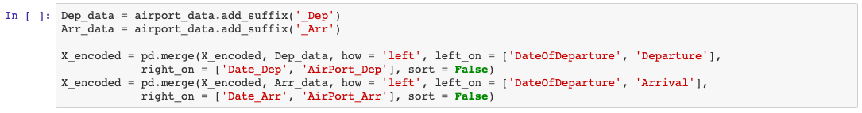
II. Data Exploration (EDA) and Feature Engineering
Data pre-processing: cleaning, merging, encoding
Cleaning external data
Data manipulation with pandas, numpy and datetime
No problem with missing values
4 external datasets to merge into a single file: weather data, general data, data per airport, data per flight route
First 3 were easy to merge on airport and date
More complicated for flight route data, as it corresponds to 2 airports: to keep a single file we just concatenated
Merging with training data (feature extractor)
Feature extractor adds a ‘Route’ column and splits dates in training data to perform pd.merge with flight route data
Other data, related to single airports, is merged twice (on Departure / Arrival airports)
Feature extractor adds ‘_dep’ and ‘_arr’ suffixes to distinguish them

Slide 9
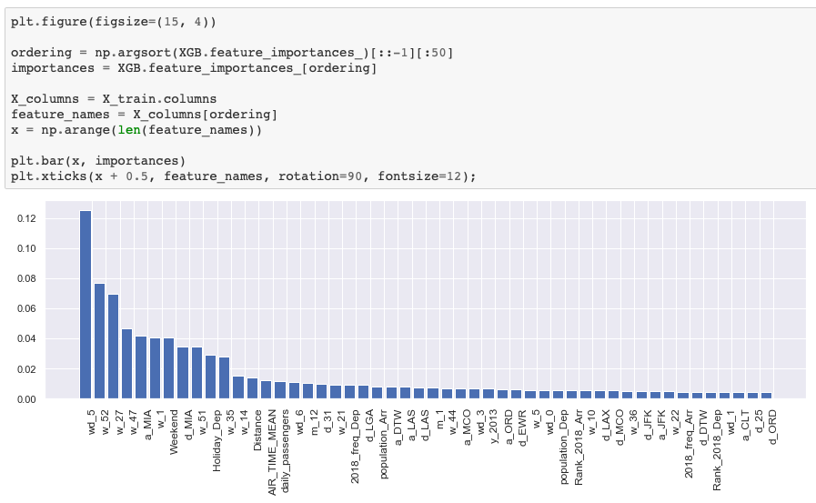
II. Data Exploration (EDA) and Feature Engineering
Data pre-processing: cleaning, merging, encoding
Encoding categorical features (feature extractor)
Target encoding did not yield satisfying results
We applied one-hot encoding to dates and airports (we also tried encoding flight routes, but it was less efficient)
Dropping irrelevant features
We made several back-and-forths with the model to test differents sets of features
Our feature extractor drops the least significant ones and outputs X_encoded to be fed to the model

Slide 10
Context and objective
Data Exploration (EDA) and Feature Engineering
Prediction (Model, Hyperparameters)
Conclusion

Slide 11

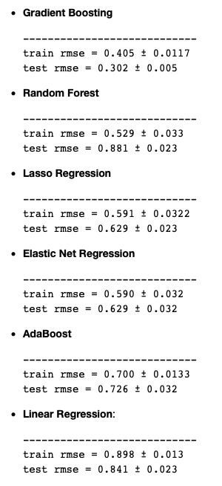
III. Prediction (Model, Hyperparameters)
Model Selection
We tried and evaluated several regression models locally.
We finally selected XGBoost.
Here are our results, ranked from lowest to highest test RMSE:
Model averaging / stacking
Overfitting
We did not get better results averaging the 3 best models.
Might be because they are already ensembling methods.
With XGBoost the model seems to overfit a little bit, but not significantly.

Slide 12
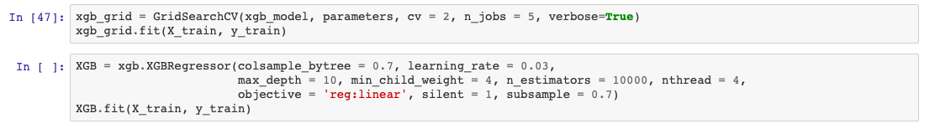
III. Prediction (Model, Hyperparameters)
Hyperparameters tuning
We performed Grid Search using the GridSearchCV command (RandomizedSearchCV is too costly).
We gained -0,17 in test score compared to default XGBoost parameters.
Below, our final model:

Slide 13
Context and objective
Data Exploration (EDA) and Feature Engineering
Prediction (Model, Hyperparameters)
Conclusion

Slide 14
IV. Conclusion
‘Business’ conclusions
Using the model we built, an airline company would be able to predict passenger load on a given route and day.
This could help them allocate planes (e.g. schedule more flights on highly-frequented routes), tune pricing policy and adjust their resource management (investments, additional staff, etc.).
Predictions could be further analysed (e.g. grouped, compared with competitors, etc.) to produce additional recommendations (determinants of traffic, preferred dates, preferred routes...) and improve business performance.
Other takeaways
Critical point of view: XGBoost is a little opaque in terms of interpretability.
We personally learnt a lot by trying and practicing the different steps of a data science project.

Slide 15
Thank you!
Q&A

